Slide 1

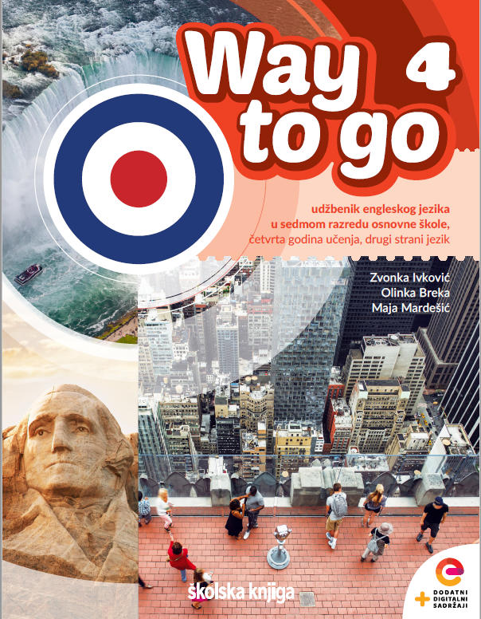
Unit 3: Lesson 10 The Curse of the Pharaoh

Slide 2
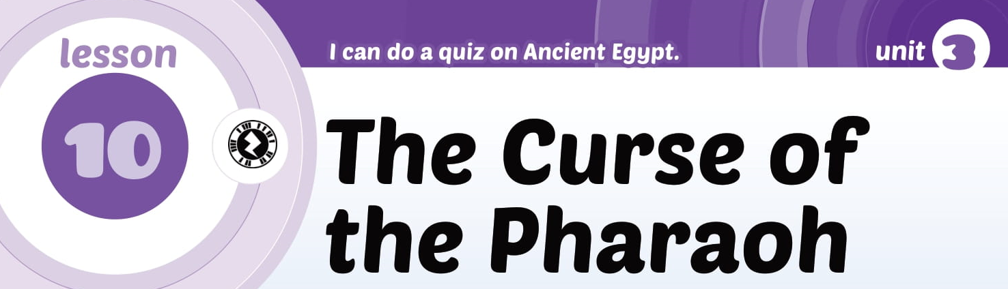
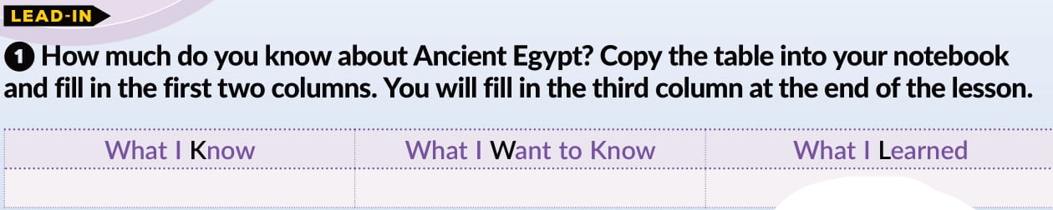

Slide 3
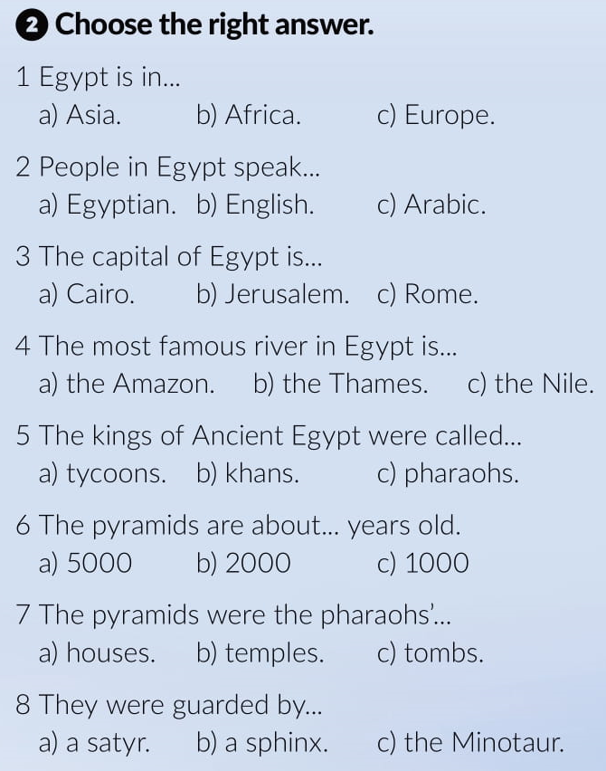
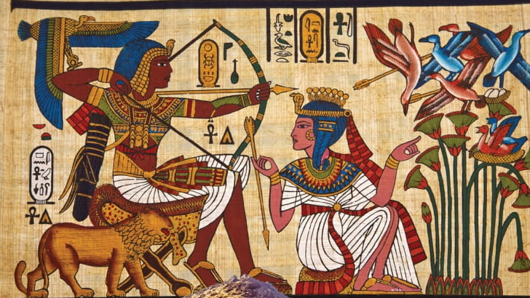

Slide 4
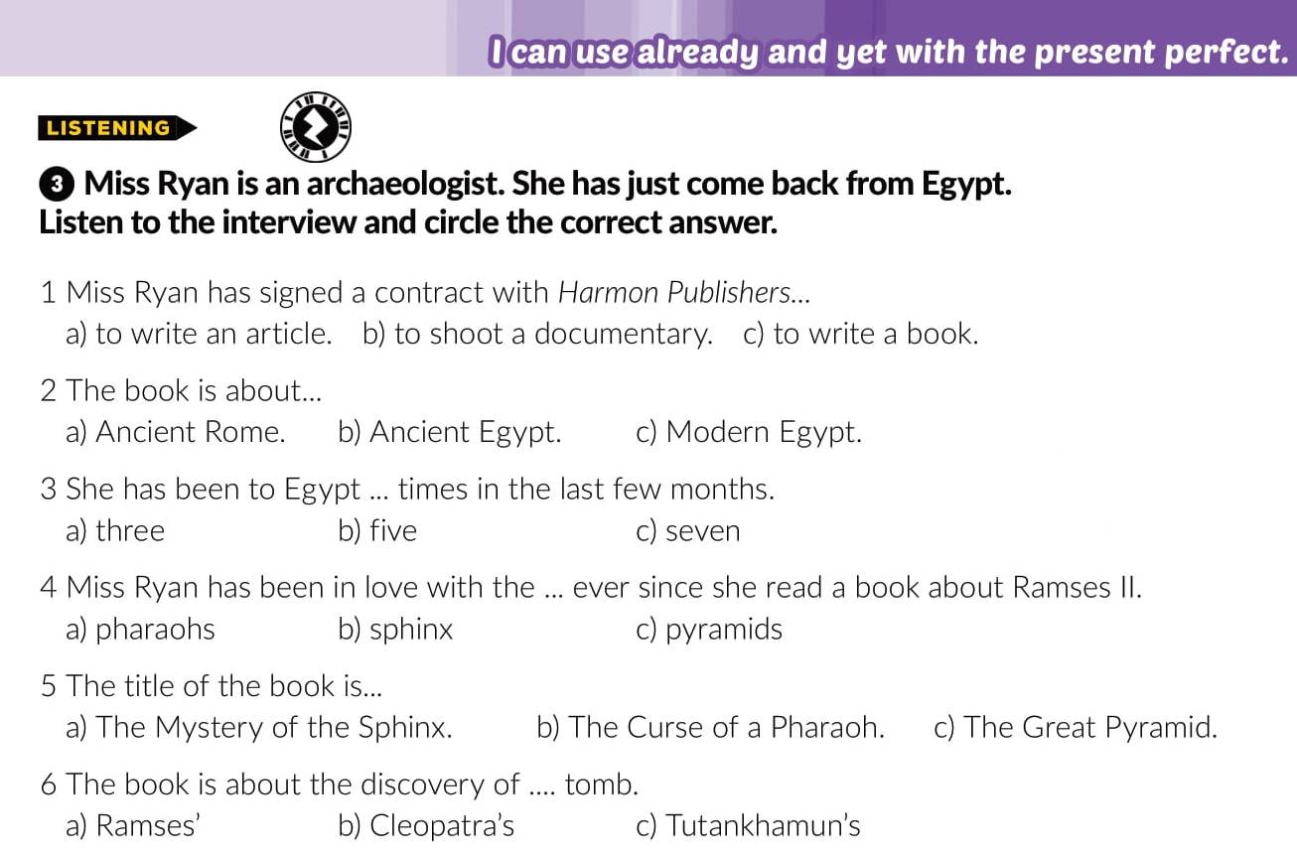


Slide 5
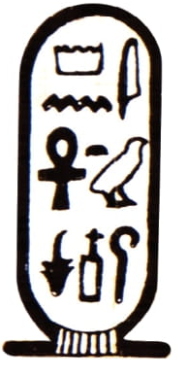

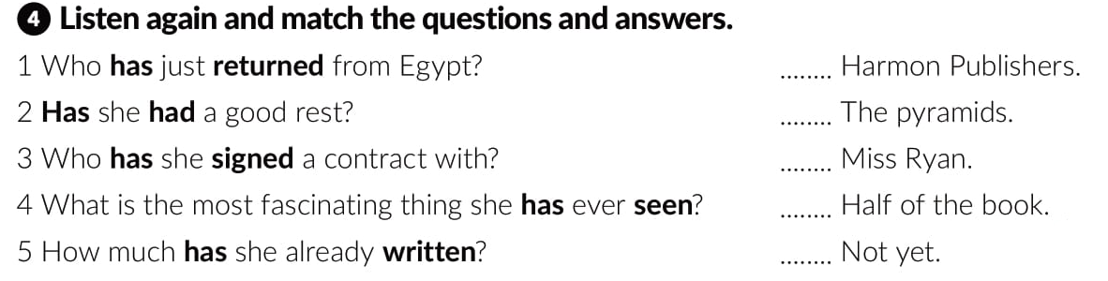
3
4
1
5
2

Slide 6

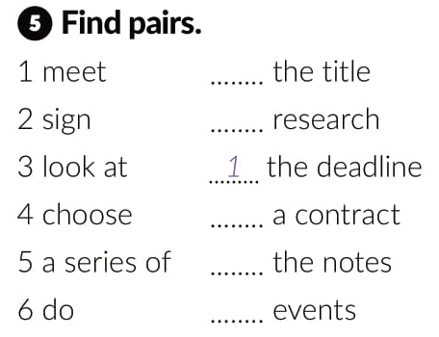
4
6
2
3
5

Slide 7
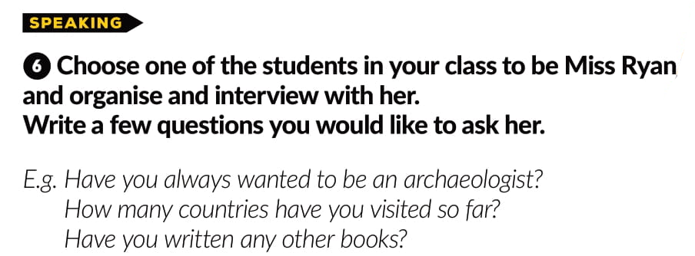
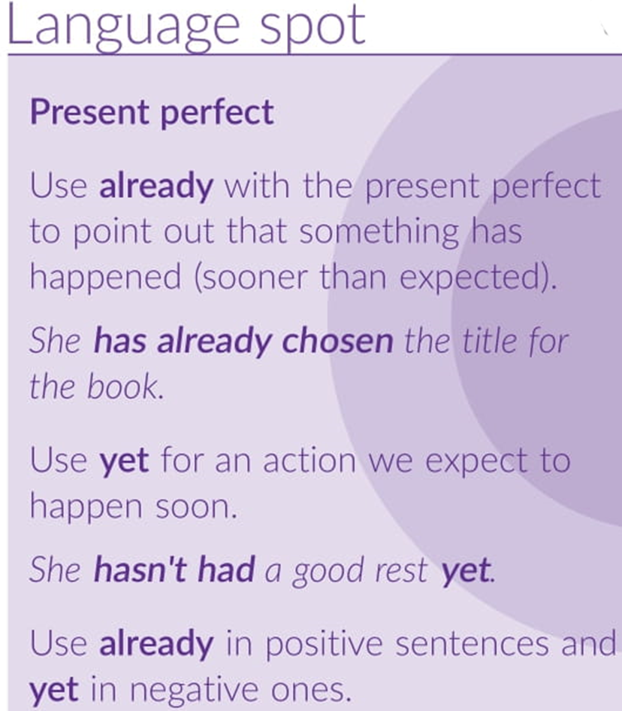

Slide 8
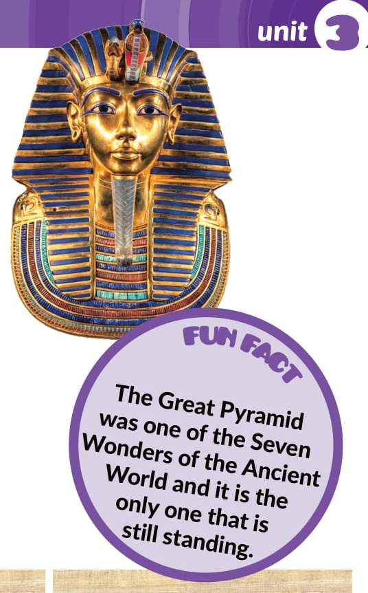

Slide 9
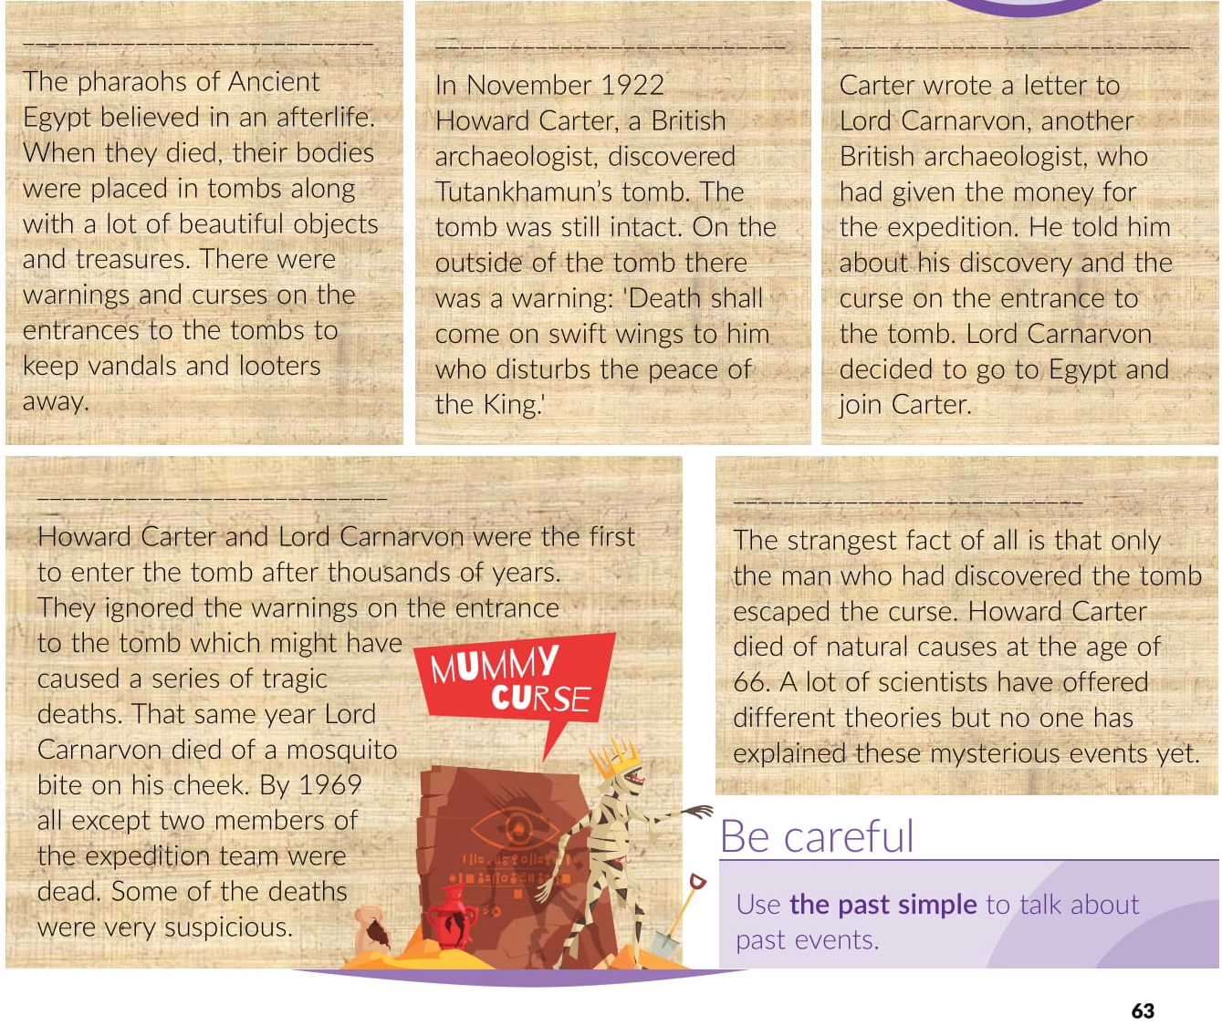
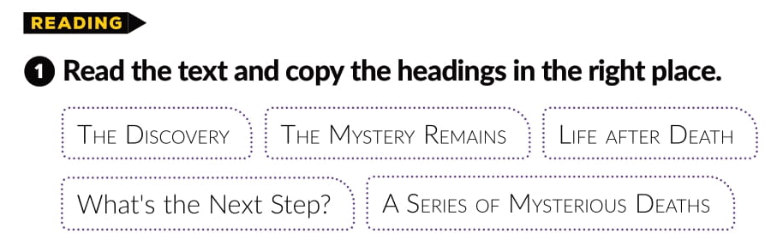
LIFE AFTER DEATH
THE DISCOVERY
WHAT’S THE NEXT STEP?
A SERIES OF MYSTERIOUS DEATHS
THE MYSTERY REMAINS

Slide 10
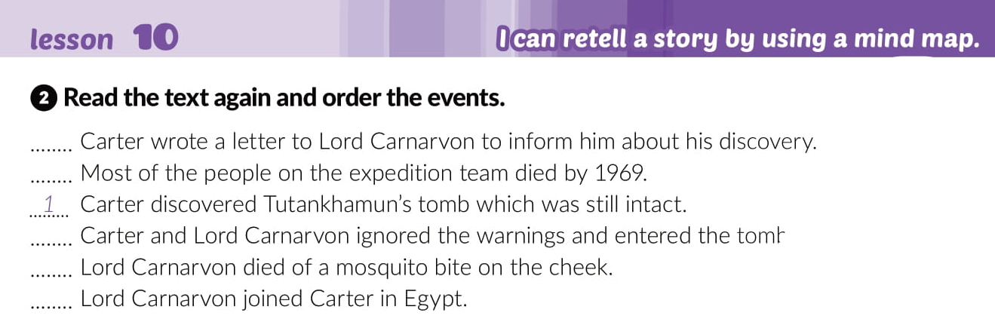

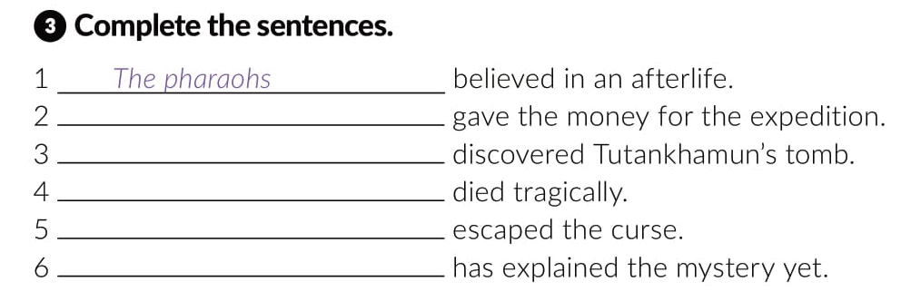
2
6
4
5
3
Lord Carnavon
Howard Carter
Lord Carnavon
Howard Carter
No one

Slide 11
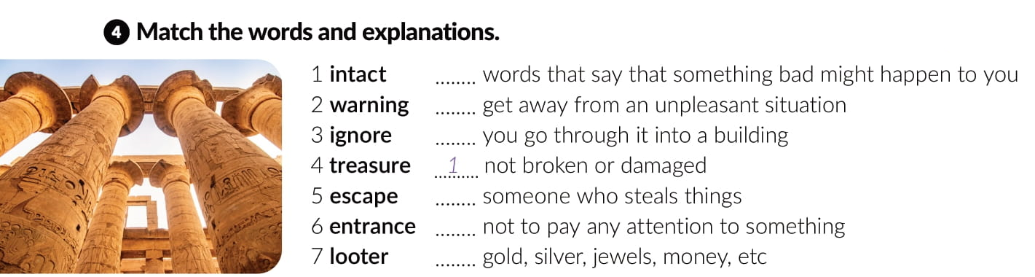
2
5
6
7
3
4

Slide 12
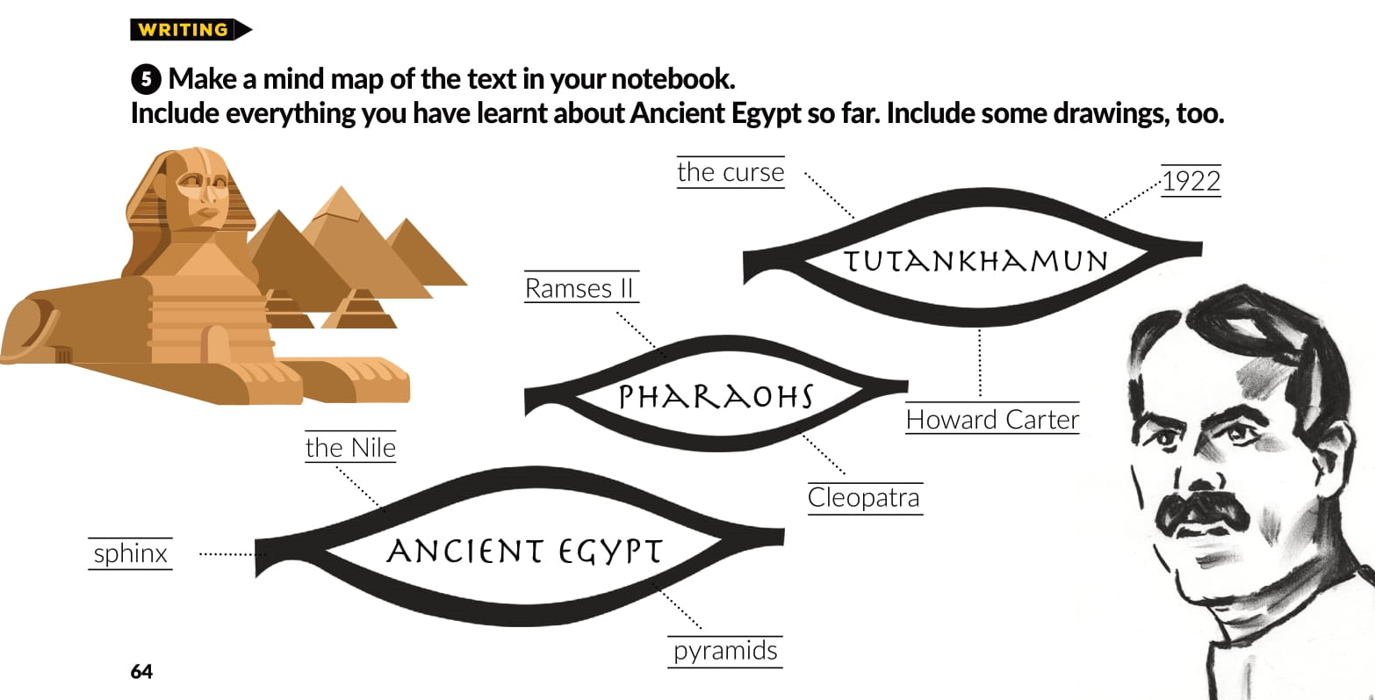

Slide 13
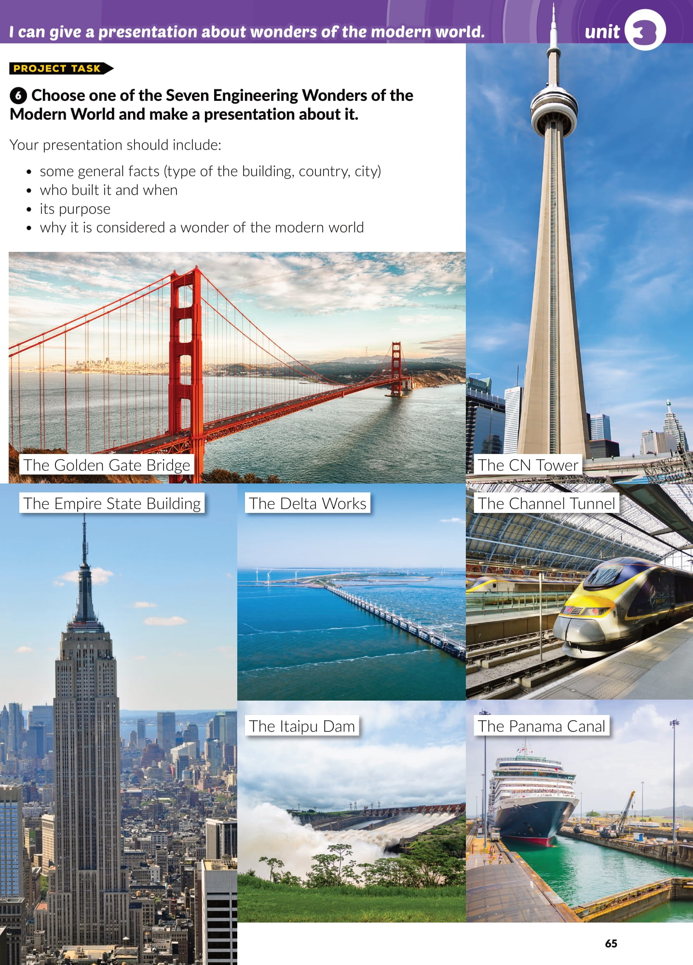

Slide 14
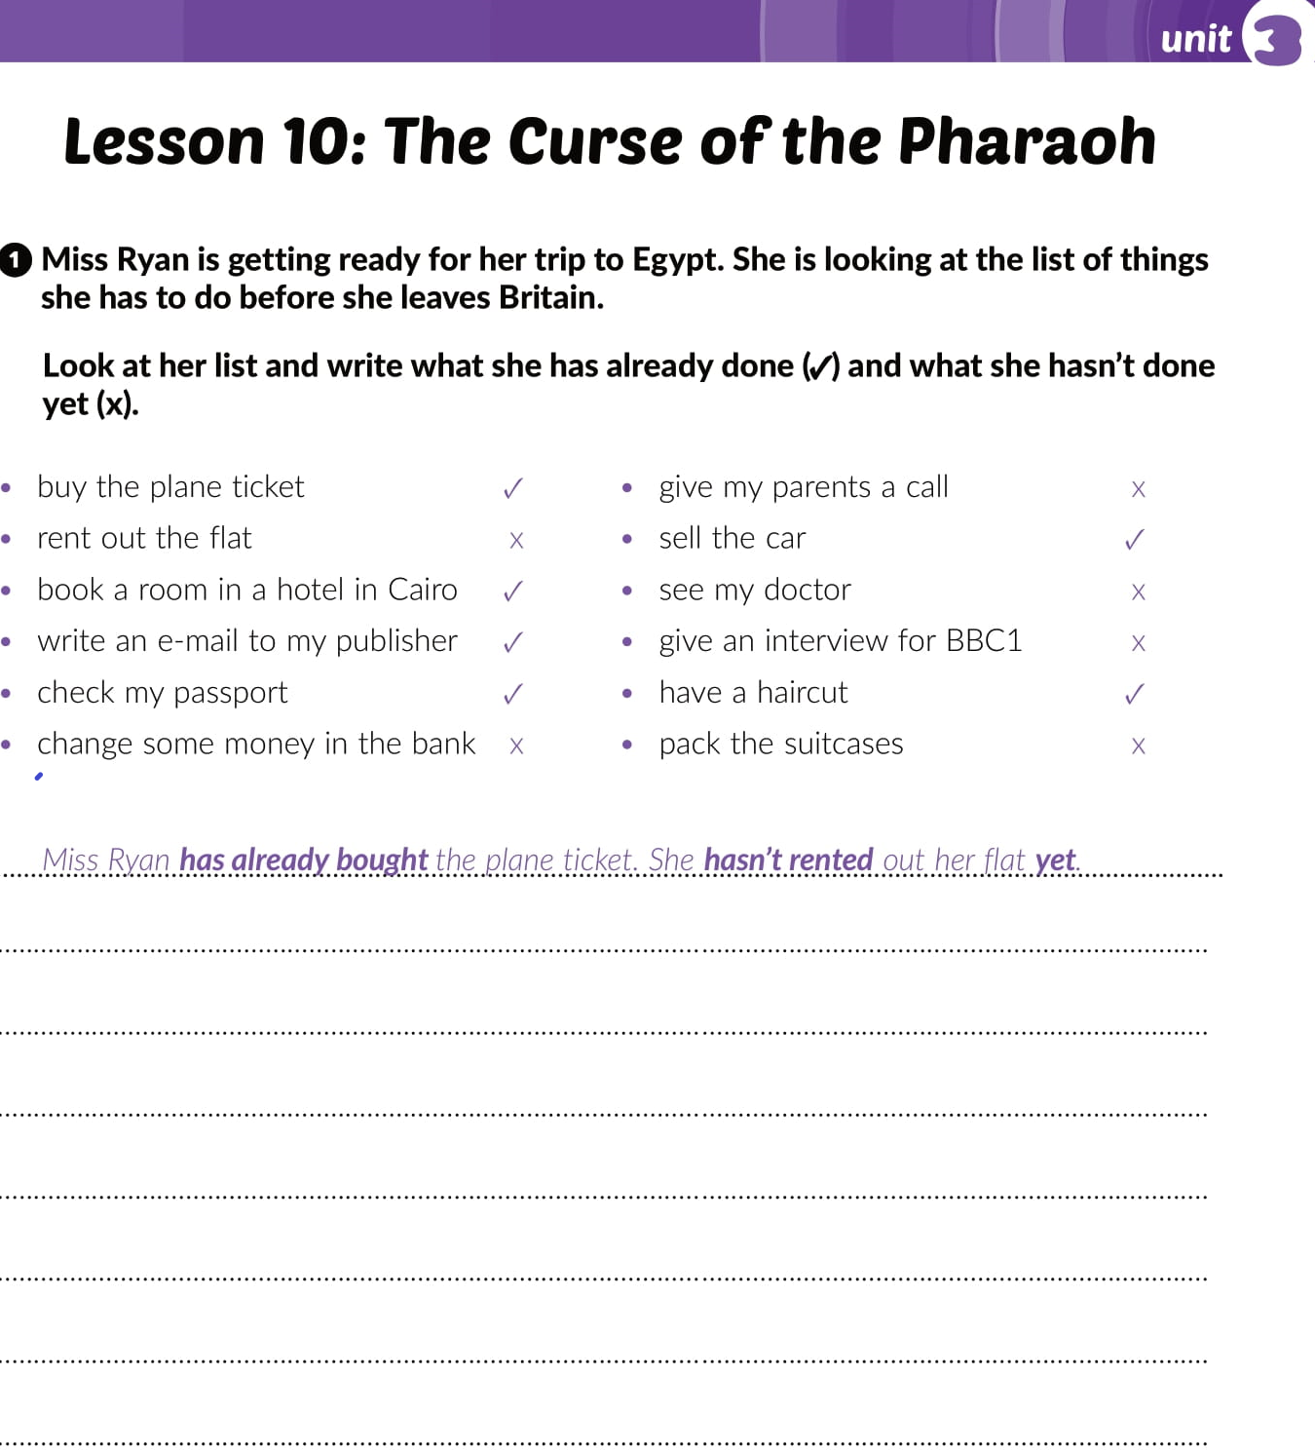
Workbook
page 41
Miss Ryan has booked a room in a hotel in Cairo. She has written an e-mail to her publisher.
Miss Ryan has checked her passport. She hasn't changed some money in the bank.
She hasn't given her parents a call.
Miss Ryan has sold the car. She hasn't seen her doctor.
Miss Ryan hasn’t given an intervew for BBC1.
She has had a haircut.
Miss Ryan hasn’t packed the suitcases

Slide 15
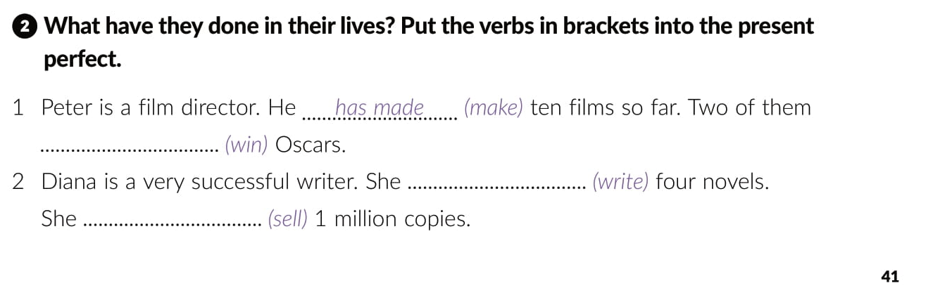
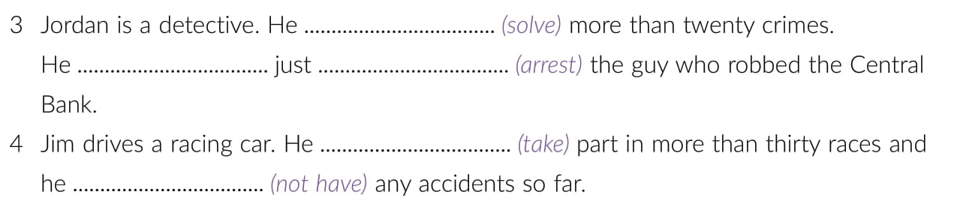
has won
has written
has sold
has solved
has
arrested
has taken
has not / hasn’t had

Slide 16
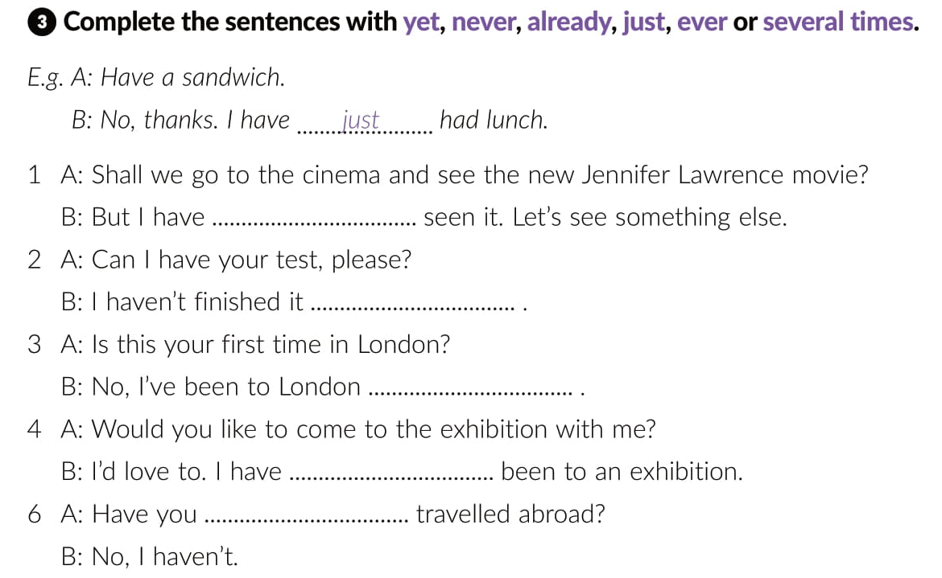
already
yet
several times
never
ever

Slide 17
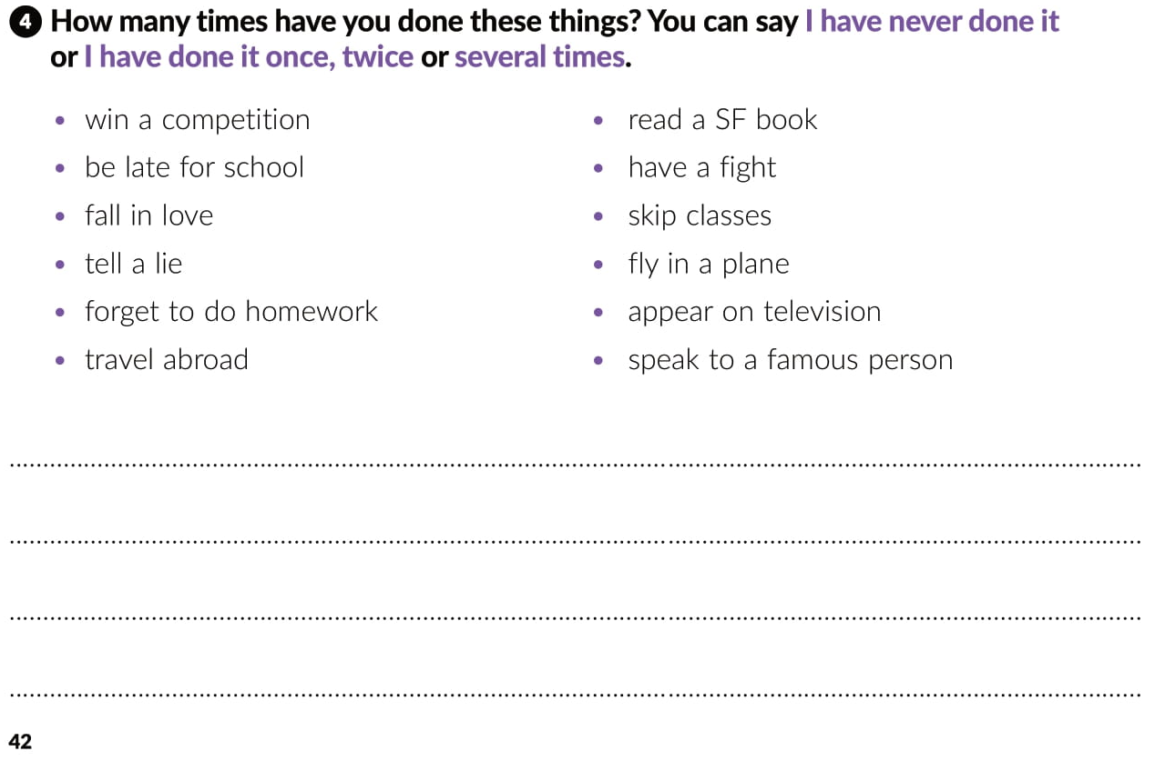
have won acompetition
have been late for school
have fallen in love
have told a lie
have forgotten to do homework
have travelled abroad
have read an SF book
have had a fight
have skipped classes
have flown in a plane
have appeared on television
have spoken to a famous pesrson

Slide 18
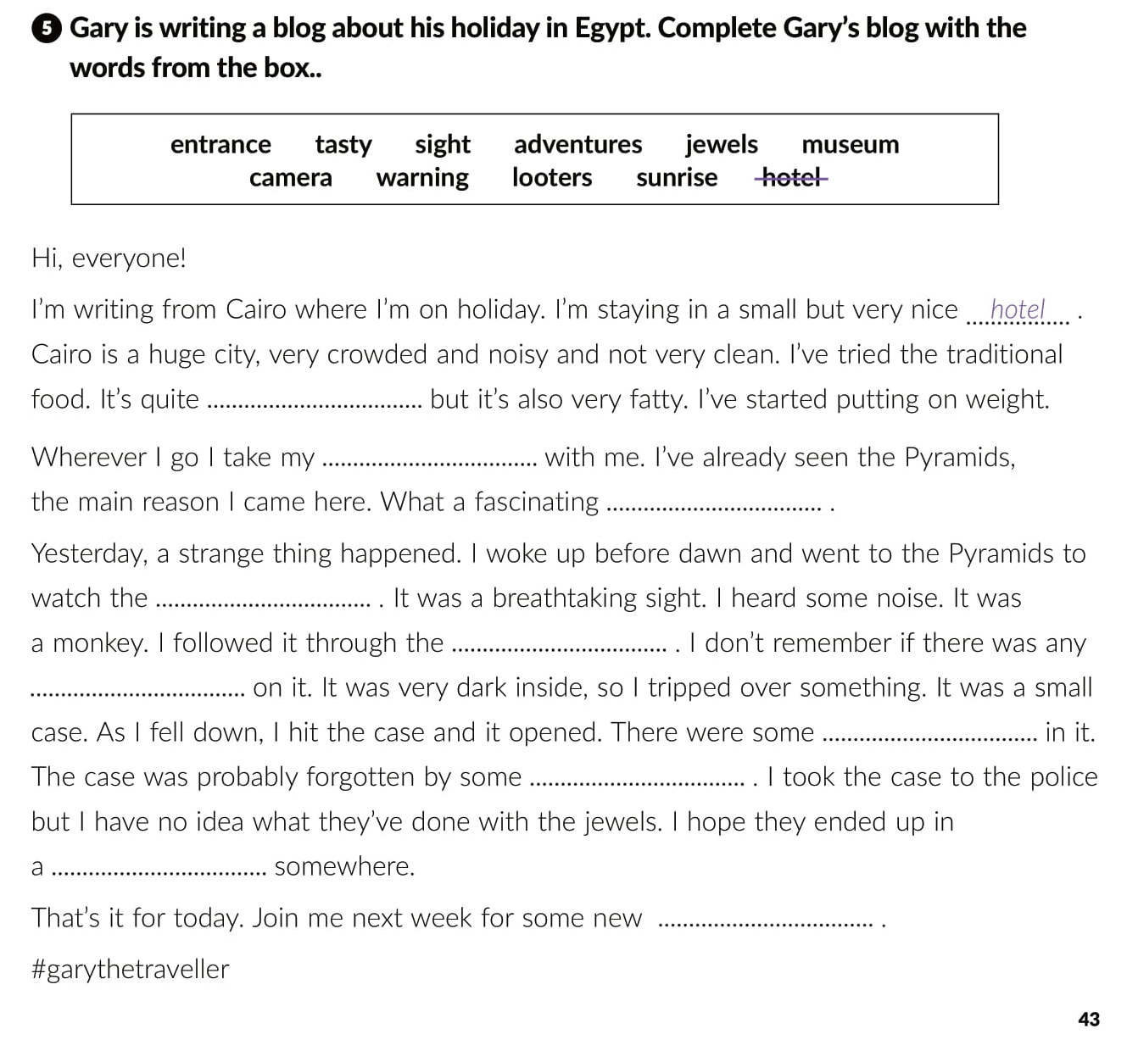
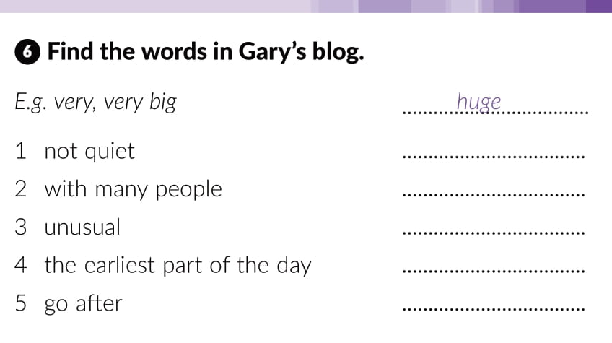
noisy
crowded
strange
tasty
sunrise
camera
follow
sight
sunrise
entrance
warning
jewels
looters
museum
adventures

Slide 19
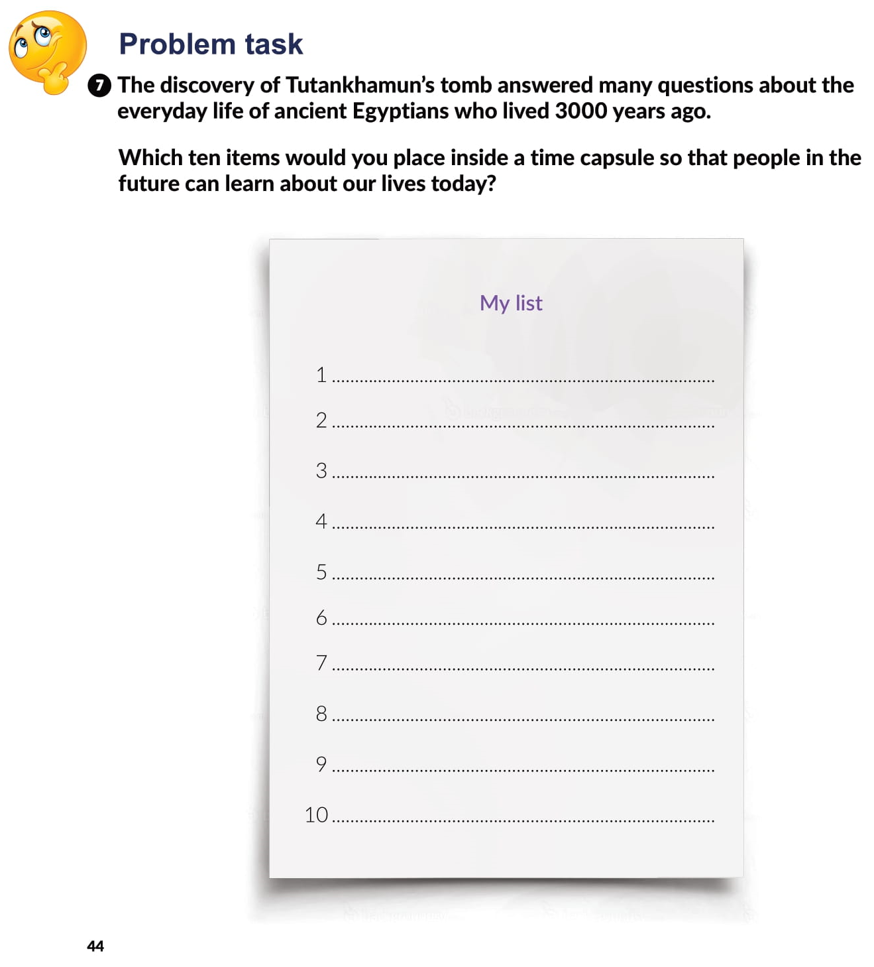

Slide 20

PLAY AND LEARN
Lesson 10 The Curse of the Pharaoh | Way to go 4 (e-sfera.hr)

